Slide 1
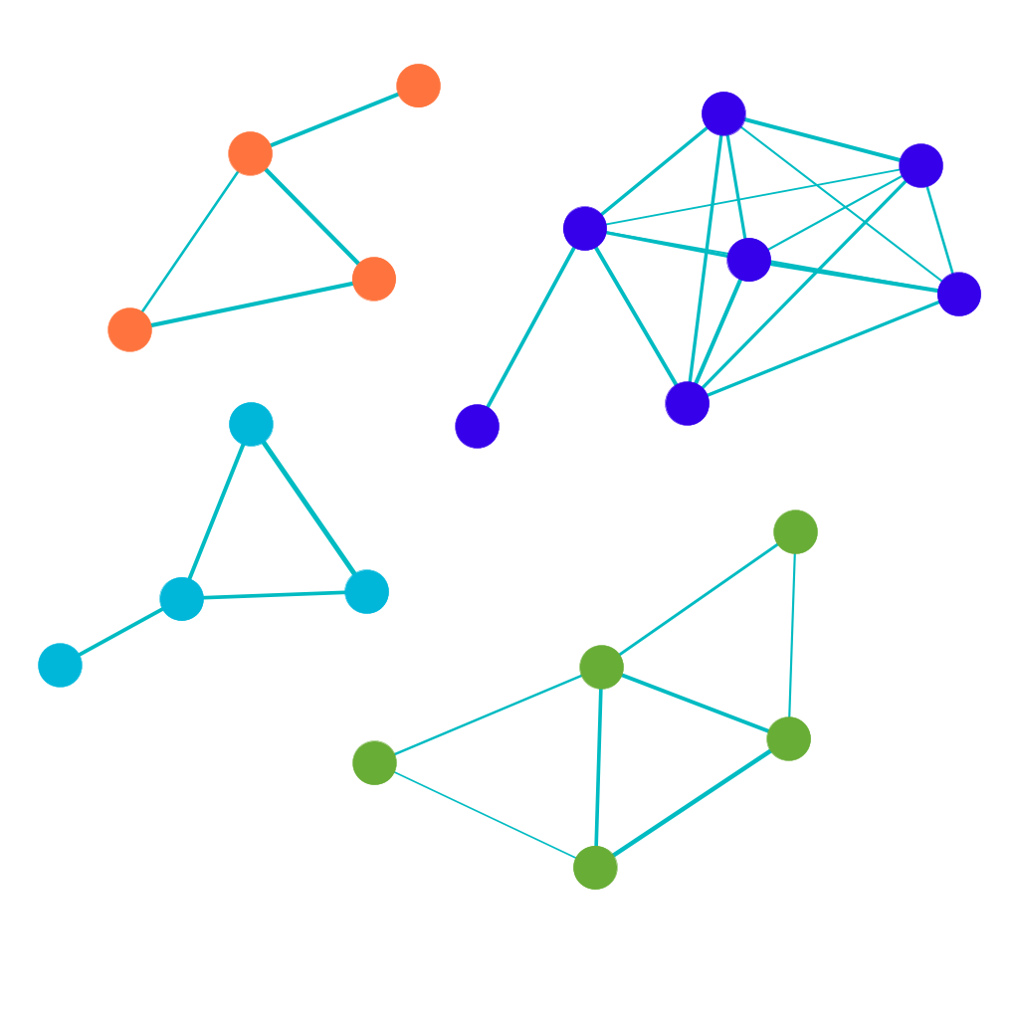
Notes:
ReconWp

Slide 2
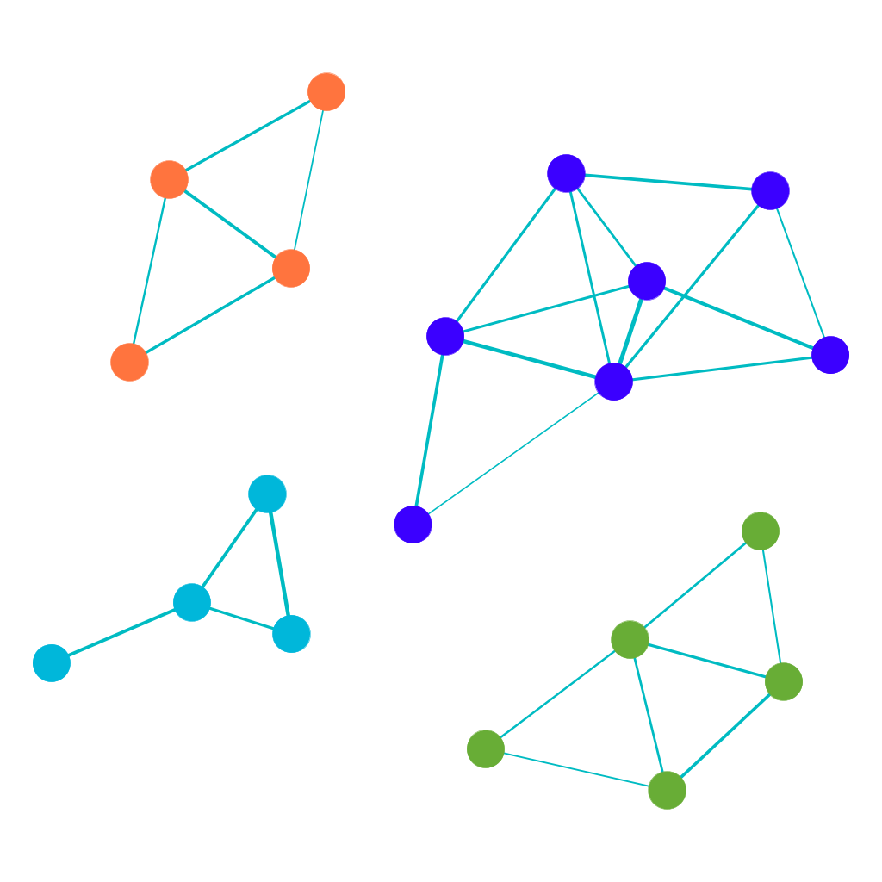
Notes:
True Wp

